Slide 1

31st Annual Conference
September 5th , 2012
New York
Effective Student Support Interventions for STEM Students
or
Montana Minds – Lessons Learned
Dr. Doug Coe
Professor of Chemistry
Dean, College of Letters, Sciences, & Professional Studies
Montana Tech
Amy Verlanic
Director The Institute for Educational Opportunities Montana Tech
Annette Kankelborg
Student Support Services Director The Institute for Educational Opportunities Montana Tech

Slide 2
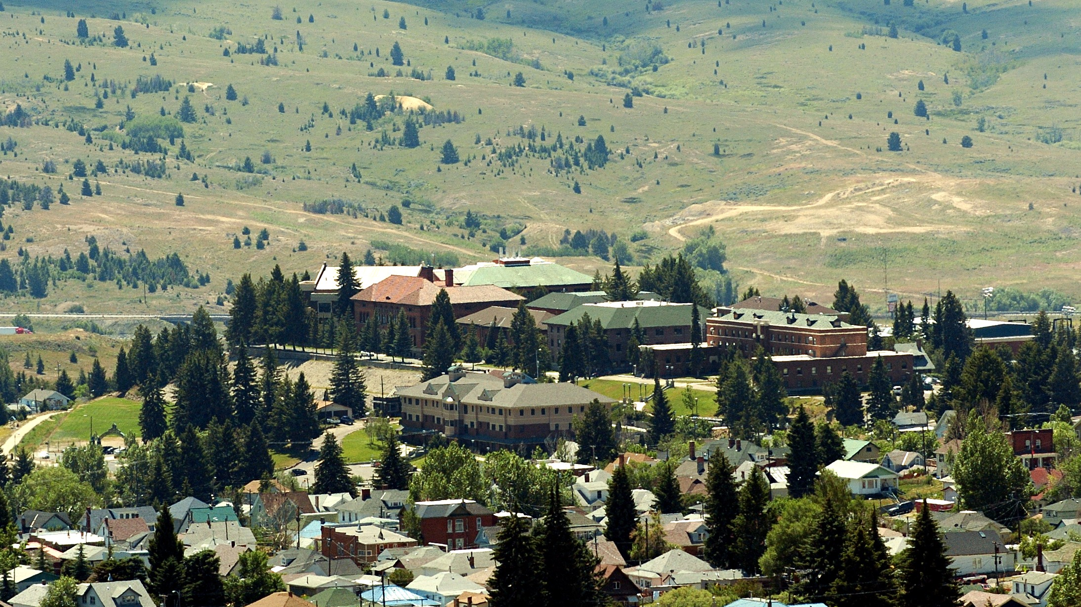
Montana Tech Campus

Slide 3
Montana Tech
To be a leader for undergraduate and graduate education and research in the Pacific Northwest in engineering, science, energy, health, information sciences and technology.
2077 students in 4 year programs (North Campus)
726 students in 2 year programs (College of Technology on the South Campus)
College of Letters, Sciences,
and Professional Studies (777):
  Biology (69)
  Chemistry (41)
  Computer Science (26) Mathematics (23)
  Network Technology (32)
  Software Engineering (22)
School of Mines and Engineering (1128):
Electrical Engineering (84)
Environmental Engineering (79)
General Engineering (288)
Geological Engineering (46)
Geophysical Engineering (14)
Metallurgical & Materials Engineering (49)
Mining Engineering (69)
Petroleum Engineering (317)
Accreditation:
  Northwest Commission on Colleges and Universities (all of Montana Tech)
  Accreditation Board of Engineering & Technology (all engineering programs & CS)
  Chemistry program (certified by the American Chemical Society)

Slide 4

S-STEM
Scholarships for Science, Technology, Engineering, and Mathematics
National Science Foundation funded program
  Support scholarships for academically talented, financially needy students, enabling them to enter the workforce following completion of an associate, baccalaureate, or graduate level degree in science and engineering disciplines.
  Funded in part by H1B work visa fees
  $50,000,000 - $70,000,000 per year
  $600,000 maximum award
  80 - 100 awards per grant cycle
  4 - 5 years duration
  Similar to SSS

Slide 5
Montana Tech’s Awards
Montana Minds – Scholarships for Science, Engineering, and Mathematics
NSF 06-527:
$489,450
2006 – 2011 (5 Years)
Supports 18 Montana Minds’ Scholars
$6,000 per scholar per year for four years
Montana Tech
Majors supported:
    Biology
    Chemistry
    Computer Science
    Mathematics
    Software Engineering
NSF 07-524:
$593,450
2007 – 2012 (5 Years)
Supports 20 Montana Minds’ Scholars
$6,500 per scholar per year for four years
NSF 09-567:
$593,450
2012 – 2016 (4 Years)
Supports 20 Montana Minds’ Scholars
$6,500 per scholar per year for four years

Slide 6
Constraints on the Awards
Typically a 6 month lag time occurred between submitting the grant and learning that you were funded.
Funds for administration and student services were limited to 15% of the scholarship amount:
NSF 06-527:
$432,000 in scholarships
$30,240 max for administration (7%)
$34,560 max for student support (8%)
NSF 07-524:
$520,000 in scholarships
$26,000 max for administration (5%)
$52,000 max for student support (10%)
NSF 09-567:
$520,000 in scholarships
$26,000 max for administration (5%)
$52,000 max for student support (10%)

Slide 7
Strategies to Overcome Constraints
NSF expects awardees' to
provide appropriate support
services to compliment the
financial aid.
Balance program staff with
those on campus with
positional authority and
those that are available and
approachable for the
students.

Slide 8
Evaluation
NSF typically expects external evaluation
National average on similar grants, 10% of award.
The grants didn’t provide funds for evaluation; but we have effective evaluation;
  Shared communication
  Track and value the hard data
  Be willing to make changes as necessary

Slide 9
Applicant Criteria
We attempted to strike a balance between merit (as a measure of the potential for academic success) and financial need.
There is a rough inverse relation between these two criteria.
Merit:
  Math ACT of 23 or SAT of 510 (M 151 – Pre-Calculus)
  High School GPA of at least 3.5 or top 10% of high school graduating class
Need:
  Defined Financial Need = Cost of Attendance - Estimated Family Contribution
  = $15,785 (in state, but not local) - EFC

Slide 10
Recruiting Strategy
Phase 1:
Interested students returned a one-page “Yes I am interested in a Montana Minds’ Scholarship” initial application that solicited key eligibility information:
  Name High School
  Intended Major ACT and/or SAT Scores
  HS GPA HS Graduation Rank
  U.S. Citizenship TRiO or GearUp participation
Phase 2:
Eligible students are notified that they are a finalist for the scholarship and invited to complete their application by:
  submitting a 400-500 word essay on:
  “Why I want to be a scientist, mathematician, or engineer.”;
  supplying two letters of recommendation (one of which must be from a science or
  mathematics teacher);
  completing a FAFSA;
  applying for admission to Montana Tech.

Slide 11
Challenges in Recruiting Scholars
NSF 06-527
291 letters to Montana high school science & mathematics teachers
350 letters to Montana high school counselors
143 letters to high school students who had expressed an interest in majoring in one of the targeted STEM disciplines at Montana Tech
135
initial applicants
71 invited
full
applications
36 with EFC
29 Fundable
24 Math
17 GPA
91 letters to TRiO advisors in high schools serving economically challenged high school students
22 awards

Slide 12
Challenges in Recruiting Scholars
NSF 07-524 Grant
238 letters to Montana high school science & mathematics teachers
330 letters to Montana high school counselors
~1,700 letters to high school students who had expressed an interest in majoring in one of the targeted STEM disciplines at Montana Tech
132
initial applicants
53 invited
full
applications
33 with EFC
21 Fundable
19 Math
15 GPA
~90 letters to TRiO advisors in high schools serving economically challenged high school students
20 awards

Slide 13
Support Structures
Students who are low-income and who may be first-generation college are more likely to persevere and succeed if they are assimilated into a community and have access to an array of support structures.
  registering in Learning Communities
  enrolling in a College Success course
  advising within a discipline by a single faculty member
  providing carefully selected upper division undergraduate mentor/tutors
  access to Montana Tech’s Learning Center
  encouraging involvement in student clubs
  organizing opportunities for social interaction
  encouraging participation in undergraduate research and attendance at seminars
  funding travel home over academic breaks to visit family & talk to HS classes
  visiting national science and engineering laboratories
  supporting travel to a national meeting

Slide 14
Learning Communities
Enrollment in Learning Communities ensured that the scholars took several first semester classes together and developed friendships and common social support structures.
Implementation requires effective cross-campus communication.
Learning Community I |  |  |  |  | Learning Community II
M | 151 | Calculus I | 3 |  | M | 121 | Pre-Calculus | 4
CHEM | 141 | College Chemistry I | 3 |  | CHEM | 141 | College Chemistry I | 3
CHEM | 142 | College Chemistry I Lab | 1 |  | CHEM | 142 | College Chemistry I Lab | 1
WRIT | 101 | College Writing I | 3 |  | WRIT | 101 | College Writing I | 3
MT | 1016 | College Success | 2 |  | MT | 1016 | College Success | 2
 |  | Gen. Education Elective | 3 |  |  |  | Gen. Education Elective | 3
 |  |  | 15 |  |  |  |  | 16

Slide 15
Schedule for a Major in Computer Science or Software Engineering
(16 Credits)
 |  | Mon | Tue | Wed | Thu | Fri
10:00 |  | M 121-02 |  | M 121-02 |  | M 121-02
10:30
11:00 |  | CHMY 141-02 | CHMY 143-01 | CHMY 141-02 |  | CHMY 141-02
11:30
12:00
12:30
13:00 |  | MT 1016-03 |  | MT 1016-03
13:30
14:00 |  | CSCI 135-01 | WRIT 101H-08 | CSCI 135-01 | WRIT 101H-08
14:30
15:00 |  |  |  | CHMY 143-15
15:30 |  |  | CSCI 135-11 |  | CSCI 194-01
16:00
16:30
17:00
17:30
18:00

Slide 16
Fall 2007 Learning Community Enrollment
As part of our strategy for building community we enrolled as many of the Montana Minds’ scholars in the same sections of the learning community courses as we could.
Course(s) | Section | Course Title | %
MT 1016-03 | Section -03 | College Success | 86%
COMM 1046H | Section -01 | Honor’s English Composition | 95%
MATH 1056 or MATH 1216 | Preparation for required Math courses | College Algebra (5 %) or Pre-Calculus (43%) | 48%
MATH 1516 or Math 1520H | Required Math courses | Calculus with Algebra Enhancement (14%) or Honor’s Calculus I (38%) | 52%
CHEM 1056 or CHEM 1256H | All sections of General Chemistry | General Chemistry I or Honor’s General Chemistry I | 76%
CHEM 1136 | Section -01 | General Chemistry I Lab Lec. | 67%
CHEM 1136-15 | Section -15 | General Chemistry I Lab | 57%

Slide 17
College Success Course
Enrollment in a College Success course instilled and sharpened the skills needed to succeed in college.
M.T. 1016 College Success
2 Cr. (Hrs.:2 Lec.)
This course is designed to teach students how to have a successful college experience both academically and personally. The focus will be on the development of practical knowledge and skills to assist students towards that goal. Topics include communication skills, critical thinking skills, test taking, time planning, study techniques, community and campus resources, and managing the personal and relationship issues that face many college
students. Students may use this course as free elective toward any undergraduate
degree. (1st, 2nd)

Slide 18
Single Faculty Discipline Specific Advisors
We made the department heads both senior faculty on the grants and the advisors for the scholars in that discipline.
Advantages of having a single advisor from the scholar’s academic discipline include:
  a single point of contact for the PIs;
  a common point of contact for all the Montana Minds’ scholars within that discipline;
  the luxury of choosing a faculty member who is known to be a good advisor;
  the advantage of an advisor who is familiar with both the curricular requirements and
  career opportunities in the discipline;
  cultivating the knowledge of NSF S-STEM and the particular needs of our students
  within a single faculty member;

Slide 19
Undergraduate Mentor / Tutors
Undergraduate mentor/tutors were hired to assist the scholars with their studies and help build community among these scholars.
The mentor / tutors were selected for their:
  command of the subjects in which they were tutoring;
  ability to tutor across more than one discipline;
  social skills.
The mentor tutors:
  established a schedule of 5 hours of tutoring each week;
  were provided with a room designated for tutoring the scholars;
  were invited and required to participate in all Montana Minds’ activities.

Slide 20
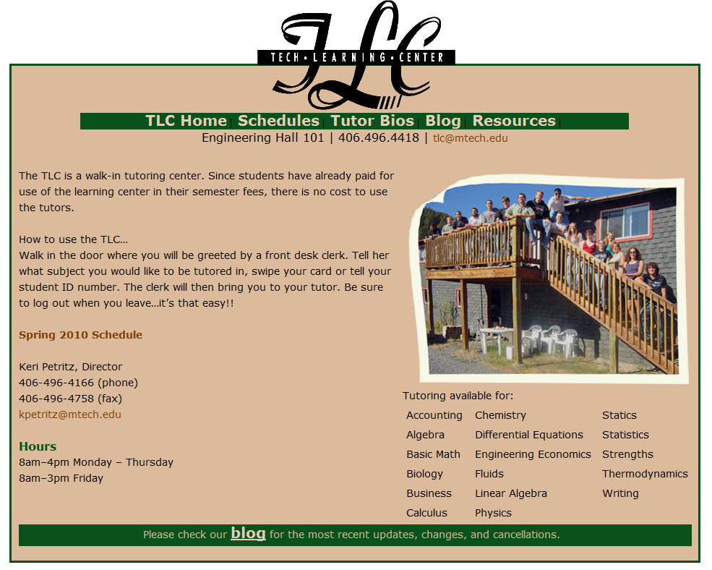
Montana Tech Learning Center
Montana Tech has an established Learning Center providing student peer tutoring in lower level mathematics, chemistry, and physics courses, as well as help with writing.

Slide 21
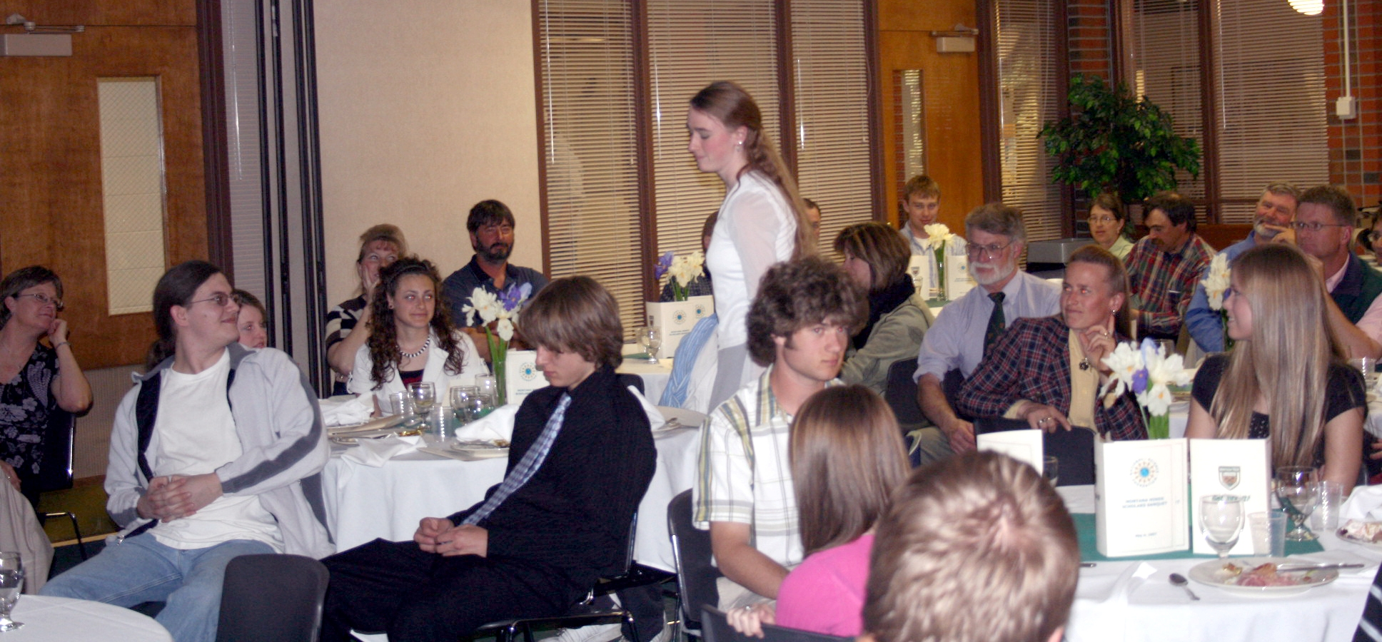
Social Activities
Social Activities, which break down communication barriers and give students, faculty, and staff an opportunity to relax and bond, ultimately strengthen community for the scholars and increase their chance of success.
Welcoming Banquet for the 1st Cohort of Montana Minds’ Scholars and Their Parents:

Slide 22

Montana Minds’ Swimming Party at Fairmont Hot Springs:

Slide 23
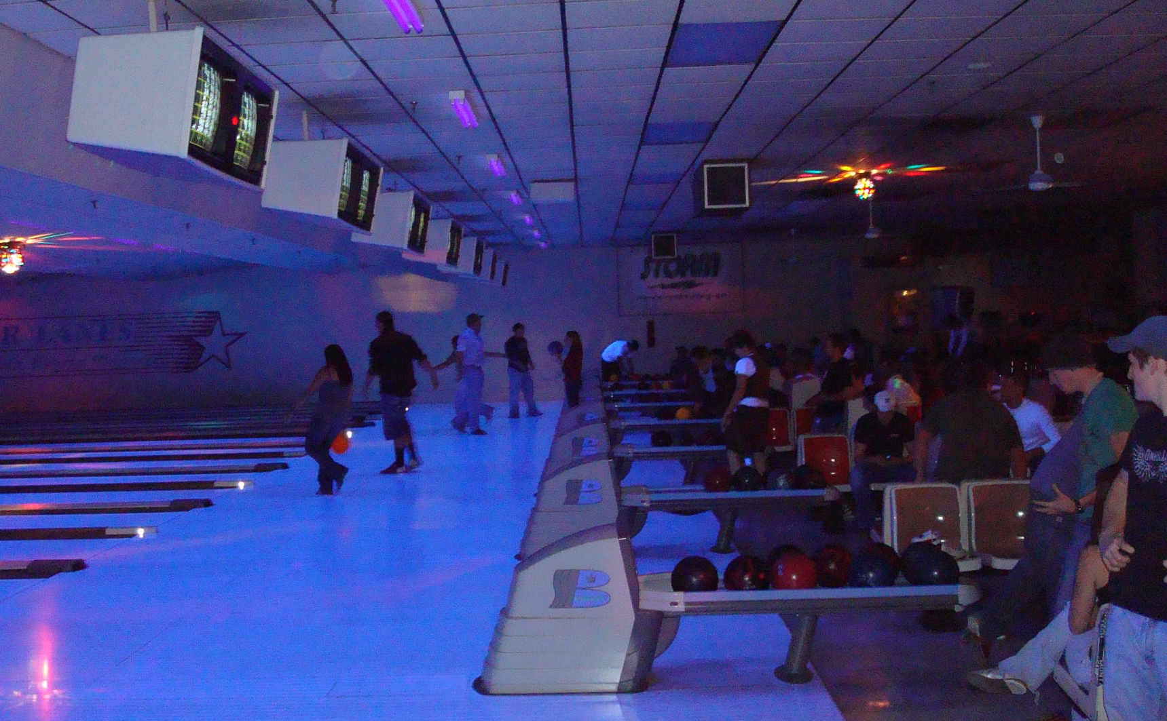
Lights Out Bowling Party at the King Pin Bowling Alley:

Slide 24
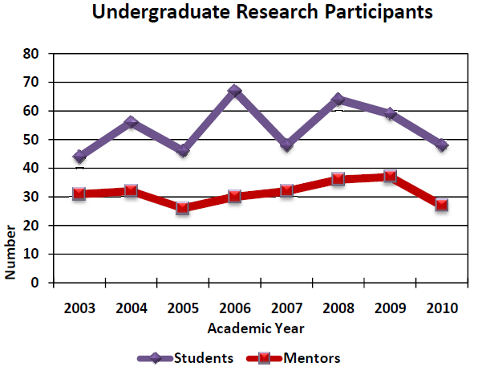
Undergraduate Research
Students who participate in undergraduate research are:
“turned on” by the excitement and experience of working with faculty and other students
in teams attacking real questions and problems;
more engaged in their classes and generally perform at a higher level in their studies;
introduced to the methods, community, values, and ethics of scholarly activity.
Montana Tech has a vigorous undergraduate research program:

Slide 25
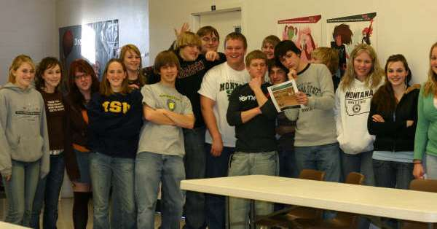
Visits Home
The PIs felt that it was important that the students stay connected with their families.
Provided a $200 honorarium to defer the cost of traveling to their home over
Thanksgiving, Christmas, and Spring Breaks
There is no free lunch – to receive the honorarium the students had to visit
science or mathematics classes in their former high school and talk about what
it was like to attend college and major in a STEM discipline
On average over both grants and five total years, 52% of the scholars took us up
on this offer

Slide 26
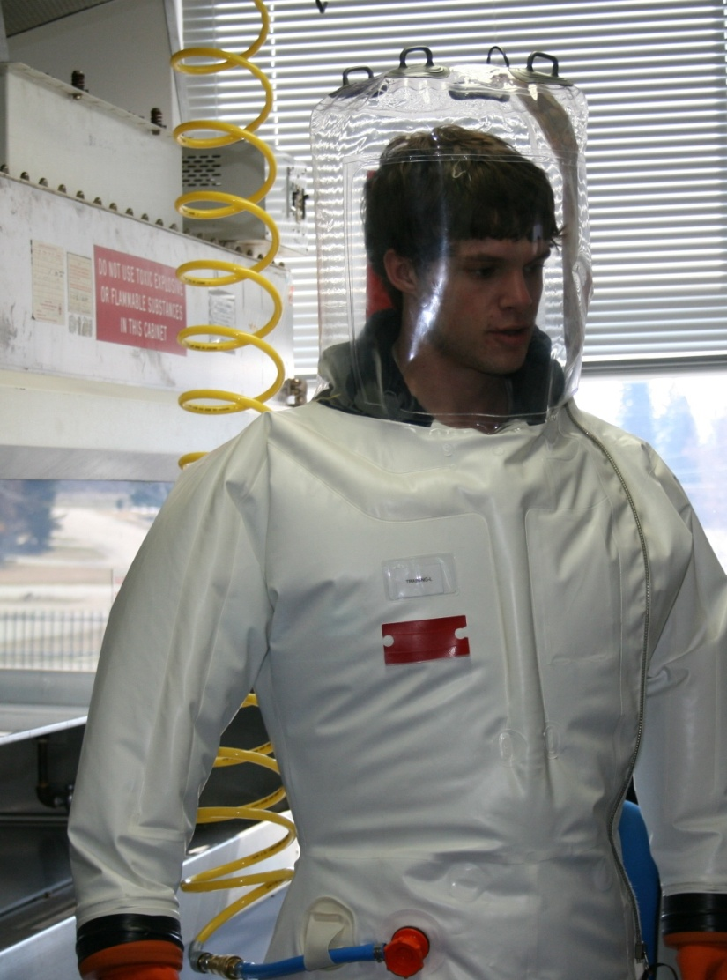
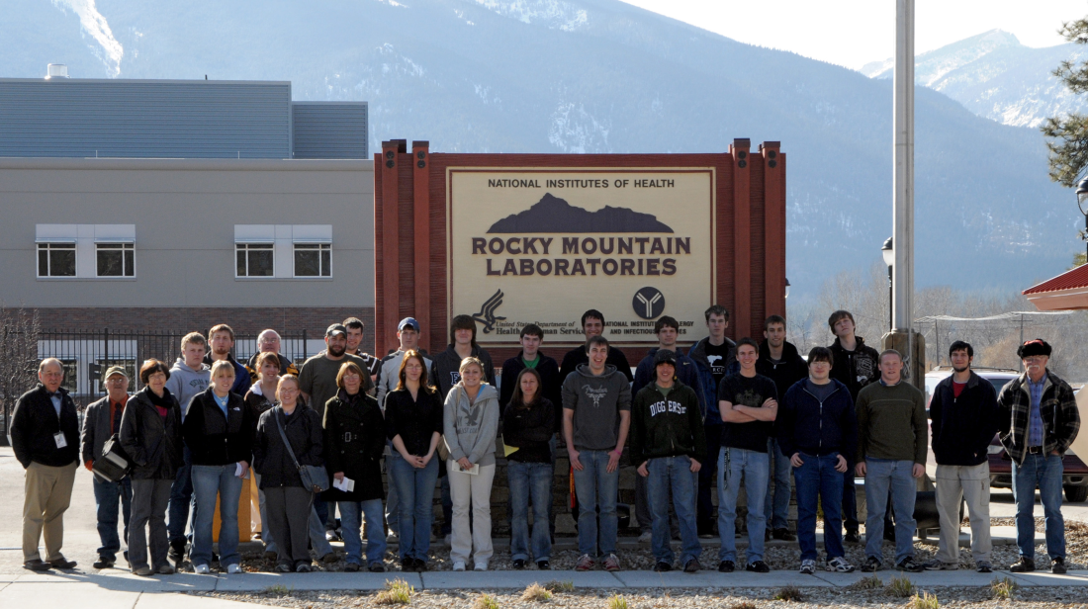
Visits to National Science and Engineering Laboratories
During the scholars freshman and sophomore years trips to national science and engineering laboratories allowed the scholars opportunity to witness science and engineering done on a grand scale and to visit with practicing scientists and engineers.
Rocky Mountain Laboratories (RML)
  National Institute of Allergies and Infectious Diseases within NIH
  Laboratory of Human Bacterial Pathogenesis
  Laboratory of Intracellular Parasites
  Laboratory of Persistent Viral Diseases
  Laboratory of Zoonotic Pathogens
  Laboratory of Virology

Slide 27
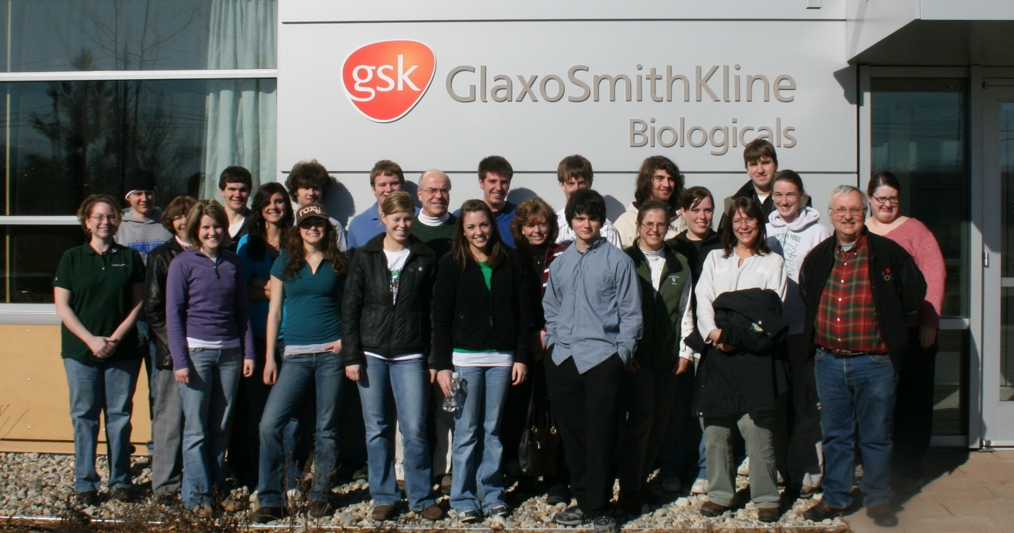
GlaxoSmithKline (GSK)
  GSK employs over 99,000 employees in 100 countries and in 2009 delivered 1.4 billion doses of vaccines and other medicines to treat asthma, viruses, infections, diabetes and digestive conditions.
  The GSK plant in Hamilton, Montana produces vaccine adjuvants.

Slide 28

Idaho National Laboratory (INL) – headquartered in Idaho Falls and covering 780 square miles of the Snake River Plain ensures the nation's energy security with safe, competitive, and sustainable energy systems and unique national and homeland security capabilities.
Arco, Idaho, adjacent to INL, was the first city to use electricity generated from nuclear energy.

Slide 29
Advising Resources
Students who have avenues to seek advising and who are encouraged to do so and who know that faculty and staff are monitoring and care about how they are doing, are more likely to be successful academically.
Montana Minds’ scholars:
were instructed to seek assistance from their course instructors and teaching
assistants, as needed;
were required to visit the Montana Minds’ mentor / tutors at least once a week;
could utilize the services of the Montana Tech Learning Center;
were encouraged to visit frequently with their academic advisor;
could seek advice from (and did seek advice from) the PIs on this grant.
could and did utilize services provided by Montana Tech’s Student Support
Services (SSS) grant.

Slide 30
Monitoring of Academic Performance
Because the early recognition of poor academic performance and the early application of corrective strategies is positively correlated with the ultimate academic success of the students, the PIs on this grant actively monitored the academic performance of the Montana Minds’ scholars:
Grades for Montana Minds’ scholars on the first exams in their common learning
community courses were monitored for early signs of academic difficulty.
Mid-Term grades for Montana Minds’ scholars were also reviewed for indications
that the scholars might be in academic trouble.
Both the mentor / tutors and the scholar’s academic advisors had been cautioned to
watch for early signs of poor academic performance and to notify the PIs and
intervene (in the case of the academic advisors)
Ultimately the scholar’s end of the semester academic transcript recorded the final
chapter on the scholar’s academic success.

Slide 31
Intrusive Advising
Students, particularly 1st and 2nd year students, often do not recognize the early signs of academic trouble. Even if they recognize that they are venturing into academic hot water, they also often do not acknowledge it. Finally, even if they both recognize and acknowledge their academic problems they do not, either through lack of inertia or of the knowledge of what to do, necessarily act to correct these problems.
For all of these reasons:
The mentor / tutors were instructed to look for early signs that the Montana Minds’
scholars were having difficulty with their courses and report this information to the
grant’s PIs.
If either mentor / tutor feedback, or early exam or mid-term grades indicated that a
scholar was in trouble in one or more of his/her courses, that scholar was sent a
letter / e-mail strongly recommending a series of actions that they could / should
undertake in order to get on track academically and avoid jeopardizing their scholarship.
The scholar’s academic advisors were copied in on this letter and encouraged to contact
the student to set up an appointment to discuss how the student was doing and to
reinforce strategies for improving.

Slide 32
Advice Given to Students to Help Them Improve Their Grades
Go to class.
Work on the homework problems far enough ahead of when they are due so that if you
are having trouble with them you have time to seek help understanding how to do them.
Go see your instructor.
Make use of the Montana Minds’ mentor / tutors.
Make use of the Montana Tech Learning Center tutors.
Increase your study time (the “rule of thumb” is 2-3 hours of outside of class study for
every hour spent in class).
Form study groups.
Study, either by yourself or with your group, in the Montana Minds’ tutor room, where,
when you have a question, a tutor is readily available.

Slide 33
Good Standing
For a student to remain in good standing with respect to the continuance of their Montana Minds’ scholarship, they must:
  continue to major in one of the five supported STEM majors; biology, chemistry,
  computer science, mathematics, or software engineering; and
  maintain:
    an overall cumulative B average (GPA of ≥ 2.67) in all of their courses;
    and
    a B average (GPA of ≥ 2.67) in all of their STEM courses.

Slide 34
Montana Minds’ Academic Probation
Students who failed to maintain the academic standards expected for Montana Minds’ scholars in a given semester were placed on probation with respect to their Montana Minds’ scholarship for the following semester and:
  required to meet at least once weekly with a Montana Minds’ student mentor/tutor;
  required to establish a schedule of regular meetings with their academic advisor, who
  by design was typicall the department head in their major and a senior faculty
  member on this grant;
Students who failed to bring their grades in the probationary semester up to the level expected for Montana Minds’ scholars were interviewed by the PIs and then, depending on circumstances revealed during the interview either:
  were continued on probation for another semester;
  or
  forfeited their Montana Minds’ scholarship.

Slide 35
Maintaining the NSF 06-527 Cohort
NSF 06-527 | 2007 | 2008 | 2009 | 2010 | 2011
# of Scholars | 21 | 21 | 20 | 21 | 11
Withdrew from Tech | 2 |  | 1 | 2
Switched Majors |  | 1 |  | 3
Transferred | 2 | 3
Lost Scholarship | 2
Graduated |  | 1 | 2 | 5 | 1
New Awards |  | 6 | 5 | 4
Cumulative Scholars | 21 | 27 | 32 | 36 | 36
There was sufficient funding left at the end of the four years of planned funding to support 11 Montana Minds’ scholars for one more semester in fall 2011.

Slide 36
Maintaining the NSF 07-524 Cohort
NSF 07-524 | 2008 | 2009 | 2010 | 2011 | 2012
# of Scholars | 20 | 21 | 20 | 18 | 7
Withdrew from Tech | 3 | 3 | 1 | 2
Switched Majors |  |  | 1
Transferred | 1
Lost Scholarship
Graduated |  |  |  | 9
New Awards |  | 5 | 1
Cumulative Scholars | 20 | 25 | 26 | 26 | 26
There was sufficient funding left at the end of the four years of planned funding to support ?? Montana Minds’ scholars for one more semester in fall 2012.

Slide 37
Surveying the Montana Minds’ Scholars
Two methods were used to gather demographic, environmental, and attitude data on the Montana Minds’ Scholars:
The NSF S-STEM Scholarship Reporting Site, which requires updating within 30 days
of the end of each semester.
  Name Start Date Major
  Scholarship GPA Class
  Employment Activities Scholarship Status
Internal Surveys, which were initially paper surveys and now use Survey Monkey.

Slide 38
What The Surveys Reveal About the Montana Minds’ Scholars
These data below are from surveys taken early in the students 2nd semester
 | NSF 06-527 | NSF 07-524
How were you recruited? | counselors, teachers | teachers, website
% planning to seek an advanced degree | 33% | 25%
Who influenced your career choice? | relatives, teachers | parents, teachers
What motivated your career choice? | money, prestige | doing good, money
When did you begin choosing a college? | junior & senior years | junior year
% attending Tech because of Montana Minds | 56% | 50%
% already intending on majoring in STEM | 44% | 87%
High school adequately prepared you for college? | 87% yes | 81% yes
% participating HS extracurricular academic activities | 63% | 62%
Number of outside of class hours spent studying | 3.7 hrs | 2.1 hrs
% using Montana Minds or Learning Center tutors | 68% each week | 21% each week
% able to balance academic & social life | 88% | 69%

Slide 39
Meeting Need
NSF 06-527 | 2007 | 2008 | 2009 | 2010
Avg. Estimated Family Contribution (EFC) | $5,335 | $4,424 | $4,047 | $4,699
Average Defined Need | $9,440 | $12,166 | $11,454 | $11,873
Average Award | $5,903 | $5,635 | $5,249 | $5,257
% Scholars with the Maximum Award | 71% | 88% | 80% | 80%
NSF 07-524 | 2007 | 2008 | 2009 | 2010
Avg. Estimated Family Contribution (EFC) |  | $3,922 | $2,770 | $4,013
Average Defined Need |  | $11,686 | $12,387 | $11,212
Average Award |  | $6,490 | $6,368 | $6,095
% Scholars with the Maximum Award |  | 95% | 95% | 90%

Slide 40
Measuring Academic Success
Academic transcripts, which yielded both grades (GPAs) and major courses successfully completed were the primary data sources used to measure the academic success of the Montana Minds’ scholars.
In order to benchmark the academic performance of the Montana Minds’ scholars, the PIs identified a comparison cohort of students majoring in the same disciplines:
 | N | ACT Math | ACT Verbal | ACT Comp. | SAT Math | HS GPA
NSF 06-527 | 21 | 25 | 24 | 24 | 593 | 3.67
Comparison Cohort | 22 | 23 | 20 | 23 | 601 | 3.27
 | N | ACT Math | ACT Verbal | ACT Comp. | SAT Math | HS GPA
NSF 07-524 | 20 | 27 | 23 | 26 | 625 | 3.72
Comparison Cohort | 18 | 24 | 25 | 23 | 603 | 3.54

Slide 41
Academic Success of the NSF 06-527 Montana Minds’ Scholars
(Following Their Junior Year)
Fall 2007 through Spring 2010
Program | NSF 06-527 |  |  |  | Comparison Cohort
 | N | Percent of Major Courses Completed | Average Cumulative GPA |  | N | Percent of Major Courses Completed | Average Cumulative GPA
Biology | 4 | 96% | 3.44 |  | 8 | 73% | 3.06
Chemistry | 5 | 88% | 3.32 |  | 1 | 66% | 3.34
Comp. Science | 5 | 91% | 3.02 |  | 1 | 38% | 1.60
Math | 2 | 79% | 3.62 |  | 0
Software Eng. | 4 | 91% | 3.01 |  | 1 | 49% | 1.66
Overall | 20 | 90% | 3.24 |  | 11 | 67% | 2.83

Slide 42
Academic Success of the NSF 07-524 Montana Minds’ Scholars
(Following Their Sophomore Year)
Fall 2008 through Spring 2010
Program | NSF 07-524 |  |  |  | Comparison Cohort
 | N | Percent of Major Courses Completed | Average Cumulative GPA |  | N | Percent of Major Courses Completed | Average Cumulative GPA
Biology | 5 | 79% | 3.09 |  | 6 | 77% | 2.72
Chemistry | 7 | 87% | 3.20 |  | 5 | 67% | 2.71
Comp. Science | 3 | 103% | 3.49 |  | 1 | 29% | 2.68
Math | 4 | 100% | 3.52 |  | 1 | 77% | 3.73
Software Eng. | 1 | 97% | 3.57 |  | 0
Overall | 20 | 91% | 3.30 |  | 13 | 50% | 2.79

Slide 43
Lessons Learned
  Be ready for surprises
  Build in opportunities for students to develop a sense of identity and belonging
  Be flexible, i.e., willing to bend the rules a little
  Provide for and utilize a variety of support structures
  Plan for and execute at least two primarily social bonding activities per year
  Don’t hesitate to stick your nose into the student’s academic business
  Show the students you care ~ and that faculty and staff are human
  Leverage the scholarships to elicit desired behavior
  Don’t underestimate the value of the little things

Slide 44

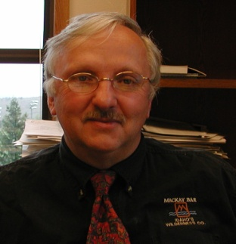

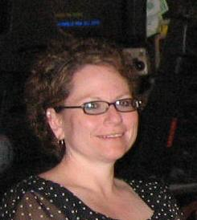





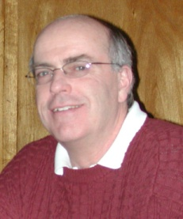
Acknowledgements
Division of Undergraduate Education
The PIs on the Grants:
Dr. Douglas Coe Chemistry
Dean
College of Letters, Sciences,
And Professional Studies
Annette Kankelborg
SSS
Institute for
Educational Opportunities
Amy Verlanic
Director
Institute for
Educational Opportunities
Senior Faculty on the Grants:
Dr. Rick Douglass Biological Sciences
Dr. Amy Kuenzi Biological Sciences
Dr. Michele VanDyne Computer Science
Dr. Celia Schahczenski Computer Science
Dr. Rick Rossi Mathematical Sciences
Dr. Douglas Cameron Chemistry

Slide 45


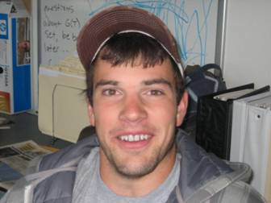
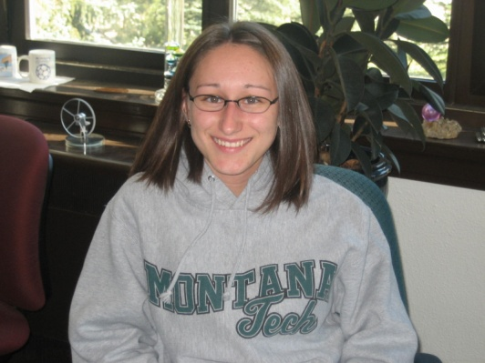
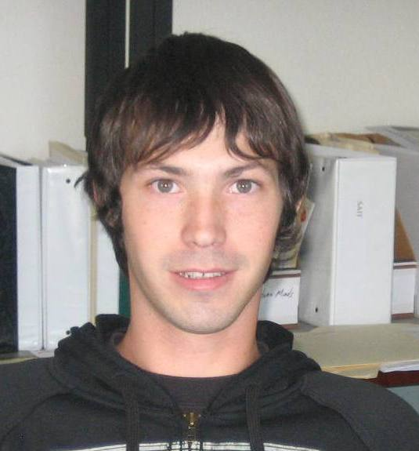
The Mentor / Tutors:
Thor Hanks Computer Science
Beverly Plumb Chemistry
Cory Sonneman Chemistry
Kimberly Jenkins Chemistry
Dan Johnson Software Engineering

Slide 46
And Of Course our Montana Minds’ Scholars!!!
NSF 06-527
NSF 07-524

